Slide 1
Ultrasonic Sensor

Slide 2
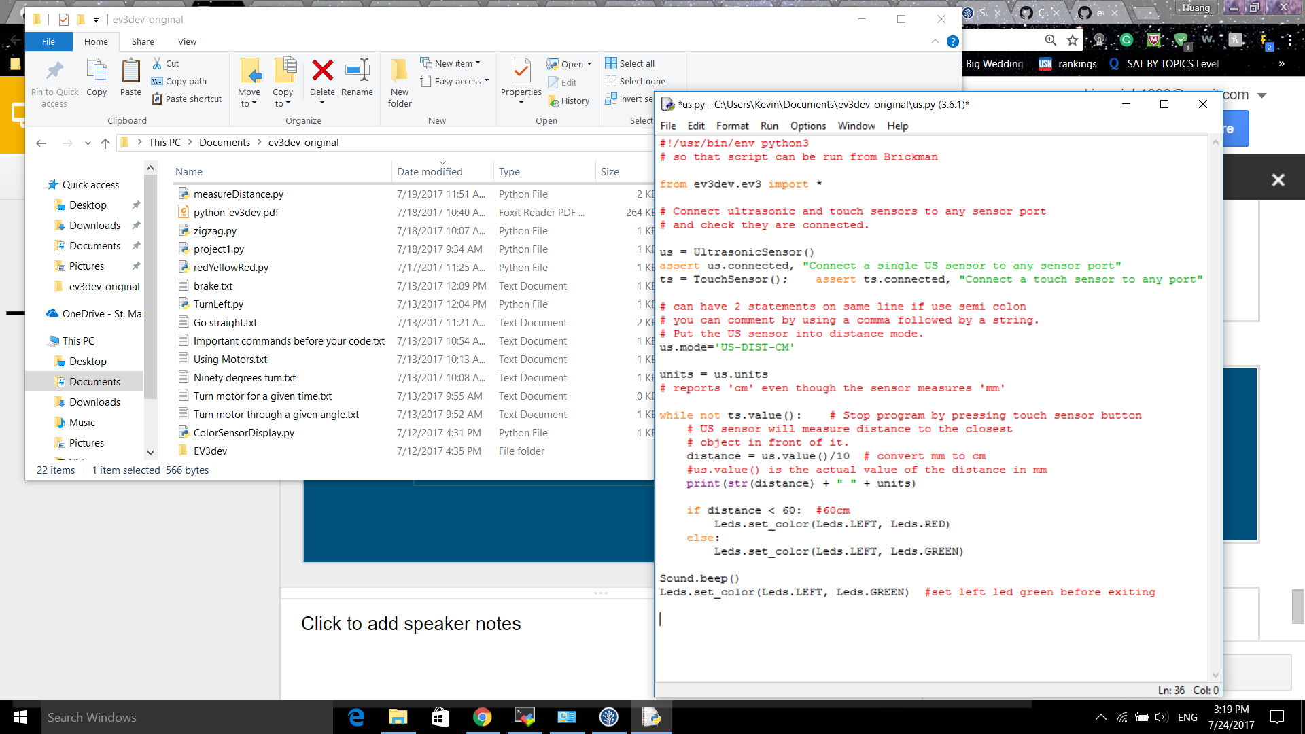

Slide 3
Exercise 1
Print out and update the distance value of the Ultrasonic sensor on the BRICK using Screen() function after every 3 seconds. Use the Touch Sensor to exit the program whenever it is pressed. Hint: Use while loop and refer to the old examples.

